Slide 1
Challenges in Information Systems Development
Based on Chapter 2 of Bennett, McRobb and Farmer:
Object Oriented Systems Analysis and Design Using UML, (4th Edition), McGraw Hill, 2010.

Slide 2
In This Lecture You Will Learn:
The main players in an IS project
The problems in IS development
The underlying causes of these problems
How the stakeholder concept helps identify ethical issues in IS development
The costs of problems and ethical issues

Slide 3
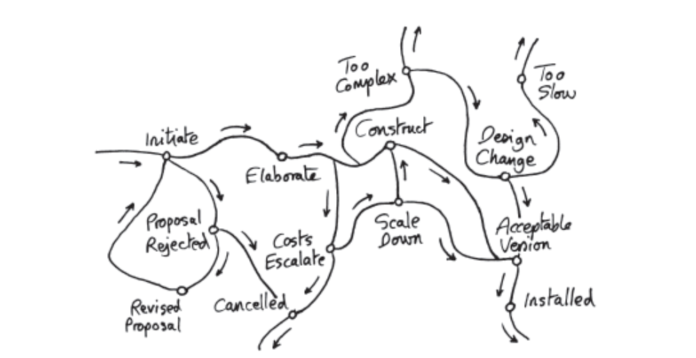
Systems Development is a Journey
Many possible routes
Developers need guidance

Slide 4
Costs of Failure
These can be very high indeed
  LSE Taurus project estimated at £480M - cancelled before delivery (Drummond 1996)
  One survey shows up to 2 projects in 3 are unsuccessful in the USA (Standish 2009)
  Another survey found less than 50% of UK projects met expectations (Veitch 2007)
But who says a project has failed?
A different picture from different stakeholders

Slide 5
What Do We Mean by Problem?
An IS project may fail before delivery
  The LSE Taurus project was cancelled
An IS may fail after delivery
  The LAS system was withdrawn after implementation
An IS may be continue to be used, despite causing problems to its users, its owners or its developers
Notes:
These examples are quite old but still instructive. You could ask your students to find more recent examples that illustrate the same problems, as a formative assignment in a lab class.

Slide 6
The Main Players
Three main types of stakeholder are involved in an IS development project:
  Those who will benefit from the system’s outputs, directly or indirectly (end-users)
  Those who commission the project, pay for it or have the power to halt it (owners or sponsors)
  Those who will produce the software (developers)

Slide 7
End-user View
End-users may be those who directly operate the software
Or they may be more remote, e.g. a manager who receives printed reports
Typical concerns include:
  A system that is promised but not delivered
  A system that is difficult to use
  A system that doesn’t meet its users’ needs

Slide 8
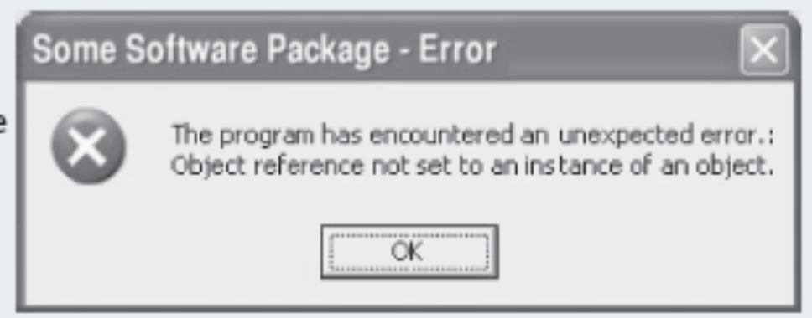
End-user View (cont’d)
Systems that are hard to use may be seen as a failure by their users
Unhelpful error messages are just one of the ways a system can be hard to use

Slide 9
Owner View
Owners care about meeting business needs and about value for money
Typical concerns include:
  Projects that overspend their budget (may no longer have a net benefit)
  Systems that are delivered too late
  Badly managed projects
  Systems that are rendered irrelevant by events
Notes:
Students could be asked during a lab class or in their own time (library research) to find recent examples of these.

Slide 10
Developer View
IS developers sometimes have a difficult time
  Budget and time constraints often conflict with doing the job properly
  Users and owners may not know how to ask for what they really want
  Technologies, development approaches and business needs all constantly change

Slide 11
Why Things Go Wrong
Whether a system is delivered or not, many things can go wrong
Flynn (1998) categorizes the main causes as:
  Quality problems
  Productivity problems

Slide 12
Quality Problems
The wrong problem is addressed
  Failure to align the project with business strategy
Wider influences are neglected
  Project team or business managers don’t take account of the system environment
Incorrect analysis of requirements
  Poor skills or not enough time allowed
Project undertaken for wrong reason
  Technology pull or political push

Slide 13
Productivity Problems
Users change their minds
“Requirements Drift”
External events
  E.g. introduction of the Euro currency
Implementation not feasible
  May not be known at start of the project
Poor project control
  Inexperienced management or political difficulties

Slide 14
Ethics Issues and
Stakeholder Problems
Some IS may affect people far beyond obvious users and owners of the system
  Cellphone companies collect data about subscribers’ calls and physical movements
  This data can be passed to police and many other government agencies
  Do you know what data is stored about you? Who by? And what it is used for?
Notes:
As a formative exercise, you could ask your students to carry out some research into these questions, and report on the results during a tutorial class.
Alternatively, this could form the basis of a piece of assessed work.

Slide 15
Stakeholder Analysis
This approach tries to identify everyone affected by a proposed IS
  Who are the stakeholders?
  How does the system affect each group?
  What are their legitimate concerns?
  Are there any legal implications, e.g. Data Protection Act in the UK?

Slide 16
Summary
In this lecture you have learned about:
The main players in an IS project, and how they perceive the potential problems
The origins of the main types of problem
How stakeholder analysis can help identify ethical impacts of an IS

Slide 17
References
Bennett, McRobb and Farmer (2010)
Flynn (1998)
See also www.ccsr.cse.dmu.ac.uk
(For further bibliographic details, see Bennett, McRobb and Farmer)

